Slide 1

Fly Your Containerized Environments by Joint Work of Harbor and Dragonfly
Steven Zou, Staff Engineer, VMware China
Allen Sun, Senior Engineer, Alibaba Group

Slide 2
Agenda
Trusted Cloud Native Registry - Harbor
P2P Based Image Distribution System - Dragonfly
Integration between Harbor and Dragonfly
Demo

Slide 3
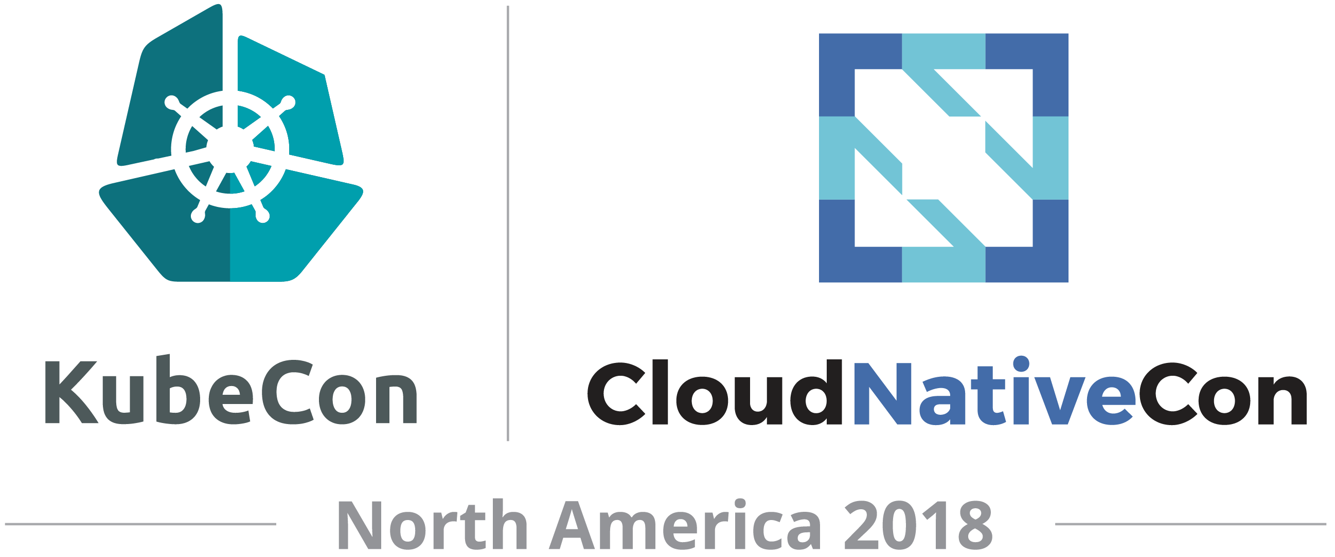

Open source trusted cloud native registry

Slide 4
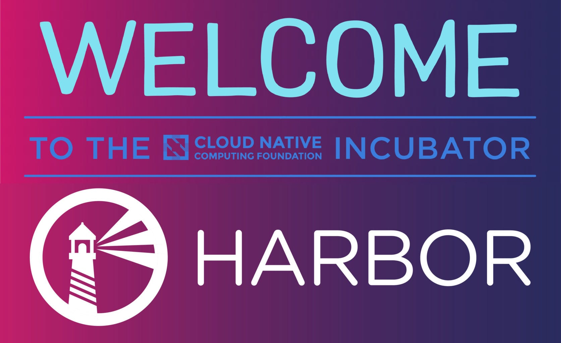


CNCF Host Project Harbor
An open source trusted cloud native registry project.
goharbor.io
Initiated by VMware China, maintained by global community
Integrated into enterprise products: VIC and PKS
Apache 2.0 license
GitHub Repo: https://github.com/goharbor/harbor/

Slide 5
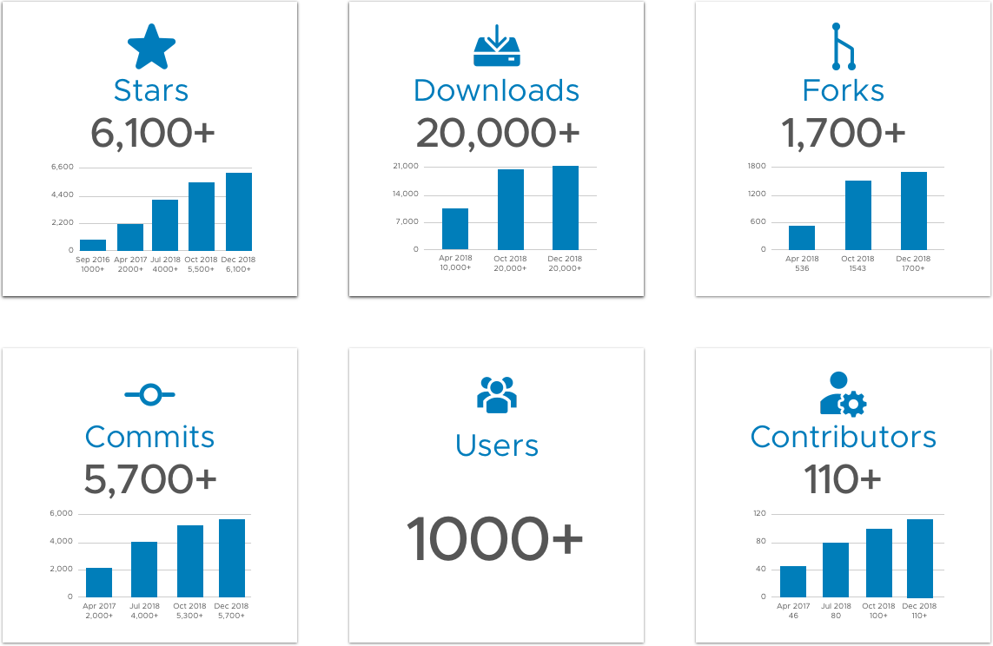
Harbor Community

Slide 6

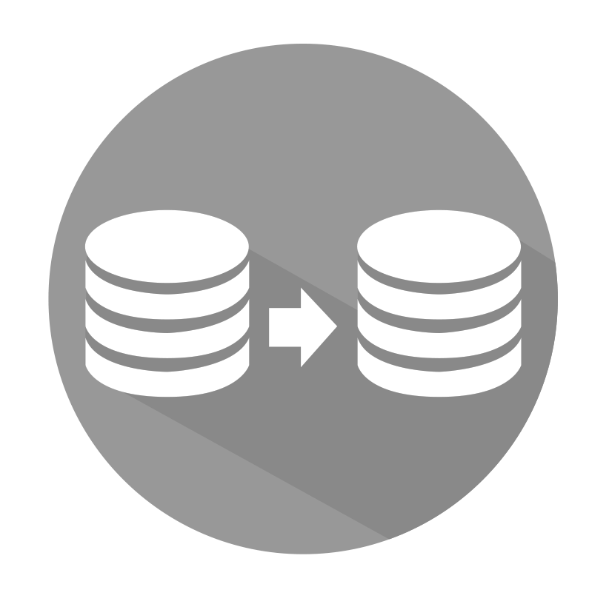




Harbor Main Features
Access Control
Replication
Vulnerability Scanning
RBAC
AD/LDAP integration
Multiple filters support
Schedule, immediate and manual trigger
Kinds of scanning policies
Elaborate scanning report
Verify vulnerability status when pulling
Content Trust
Helm Chart Support
High Availability
Digital signature
Sign image when pushing
Verify signature when pulling
Helm Chart repository
Same mechanism and user experiences with image management
HA support

Slide 7
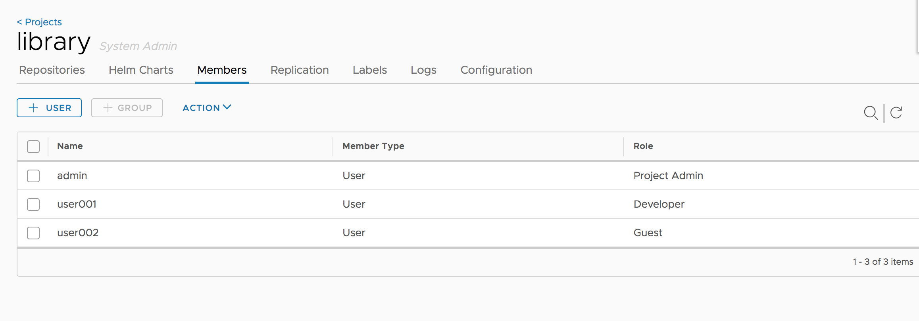




Access Control - RBAC
Project
Access Control
Images
Organizations often keep images within their own organizations
People with different roles should have different access
Different rules should be enforced in different environments
Can be integrated with internal user management system
Members
Guest:
docker pull ...
Developer:
docker pull/push ...
operation & management
Administrator:
Settings

Slide 8
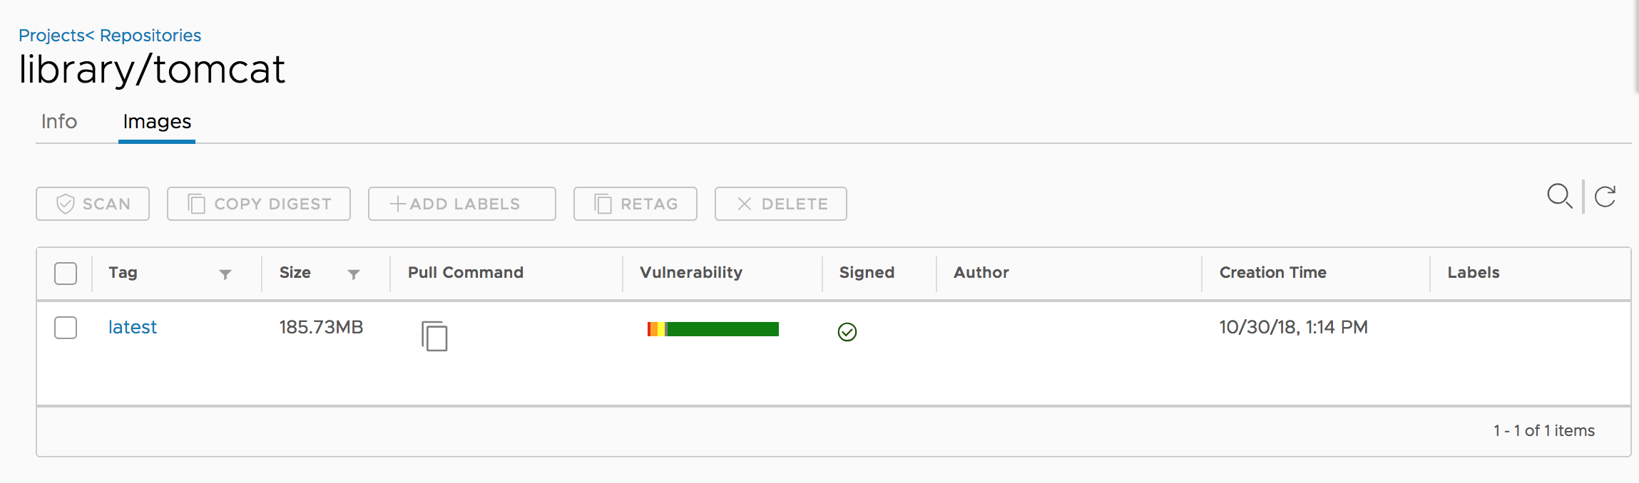
Content Trust – Sign the content
Notary
2. Signature of tag’s manifest
3. Verify signature status, fetch digest.
Content Trust
Leverage Notary to sign the content
Sign the image when pushing
Verify the signature status when pulling
1. docker push tag
4. docker pull $digest
Image Creator
Registry
Image User

Slide 9
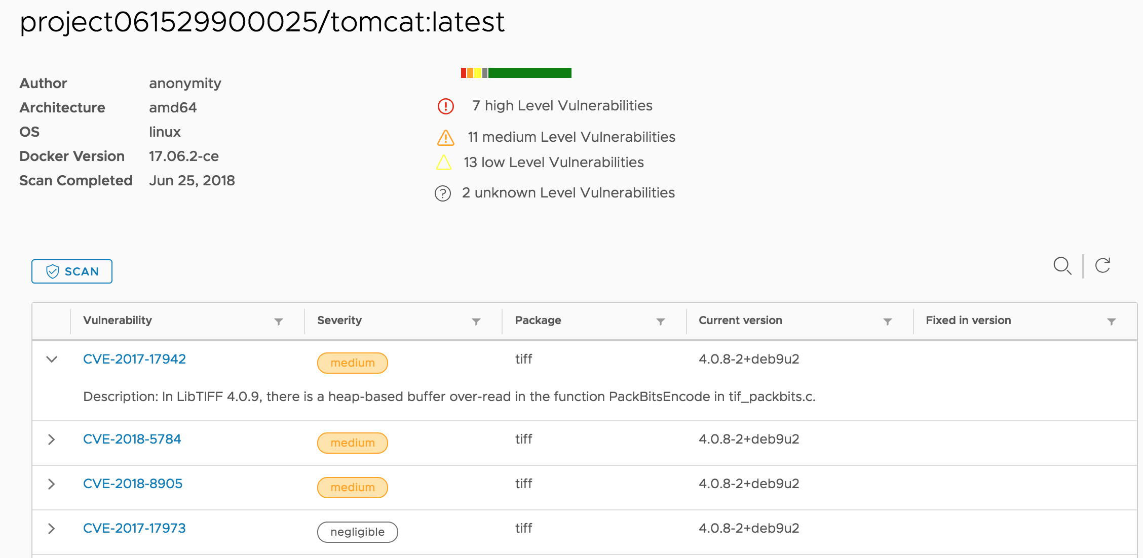
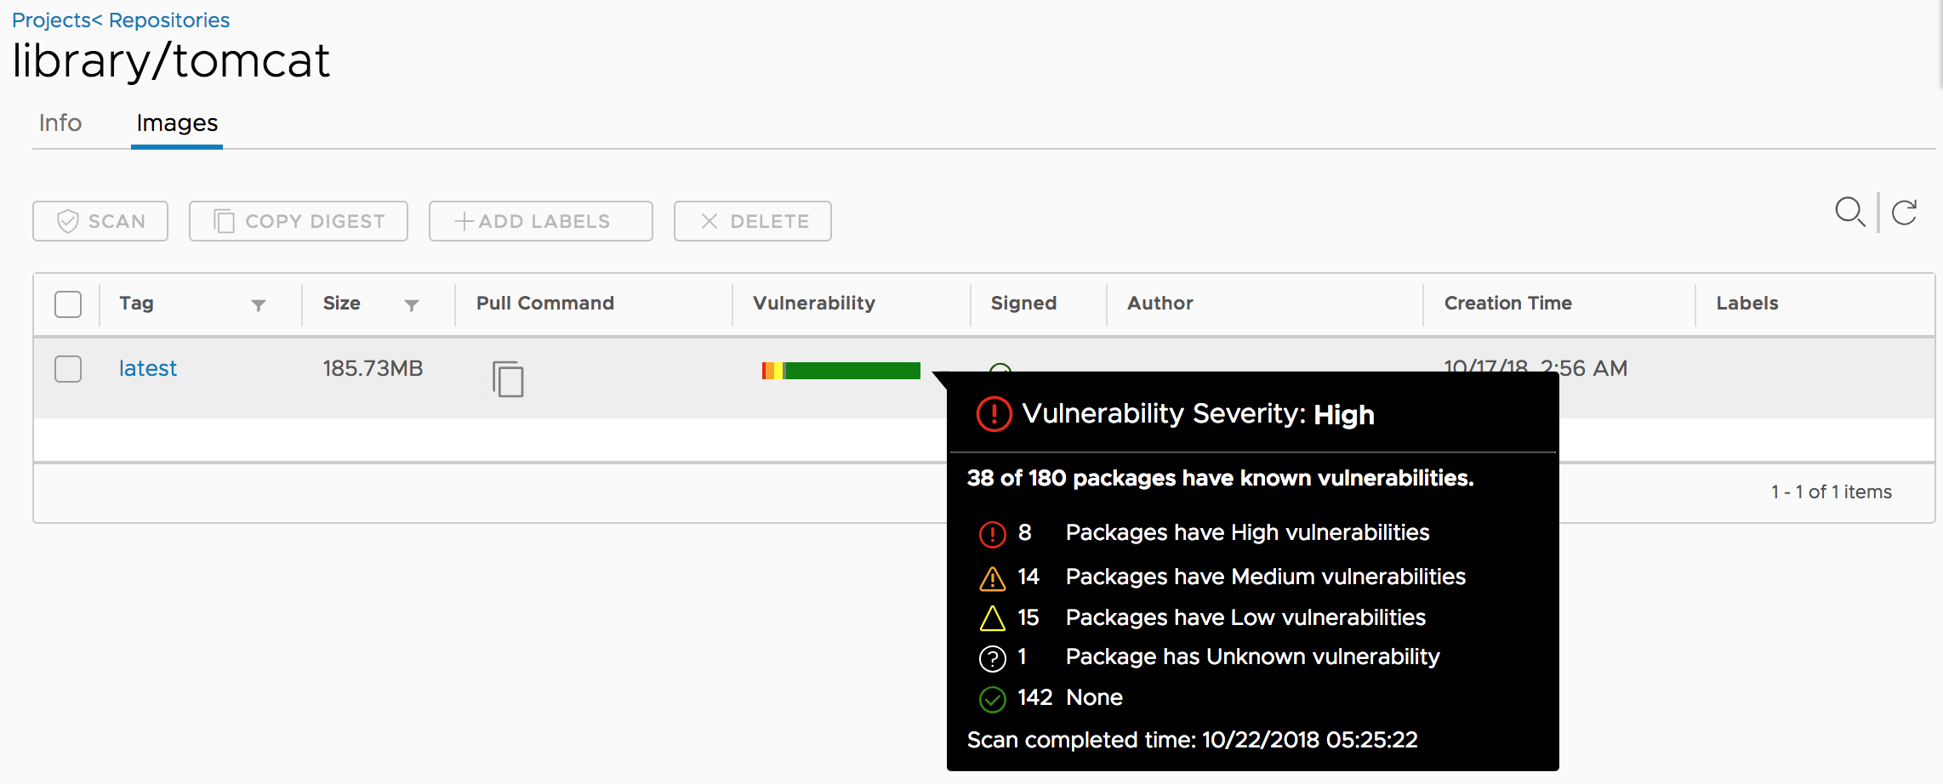
Vulnerability Scanning – Make content security
Vulnerability Scanning
Harbor
API
Job Service
Clair
Retrieve vulnerability
metadata
CVE Repos
Console
Dispatch Jobs
Scan
2
4
0
Static analysis of vulnerability
Multi Scanning Modes
Scheduled
Event
Manual
Update vulnerability data regularly
Multi CVE DB sources
Set policy control based on VUL result
Rest API
3
Get Info
6
Save Data
1
Registry V2
Pull Layers
DB
5

Slide 10
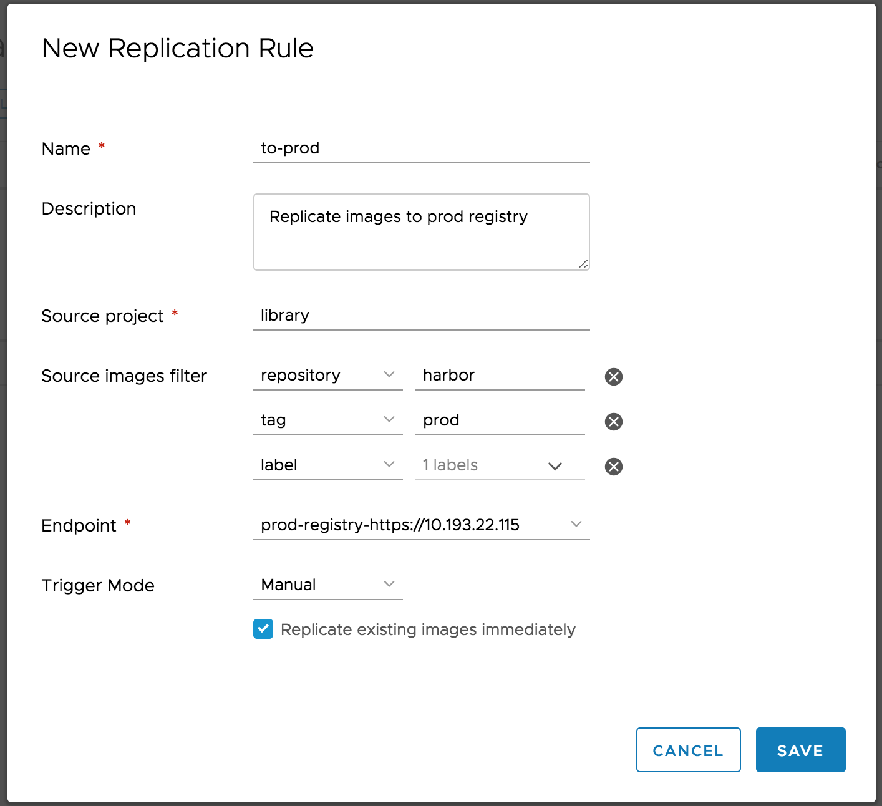
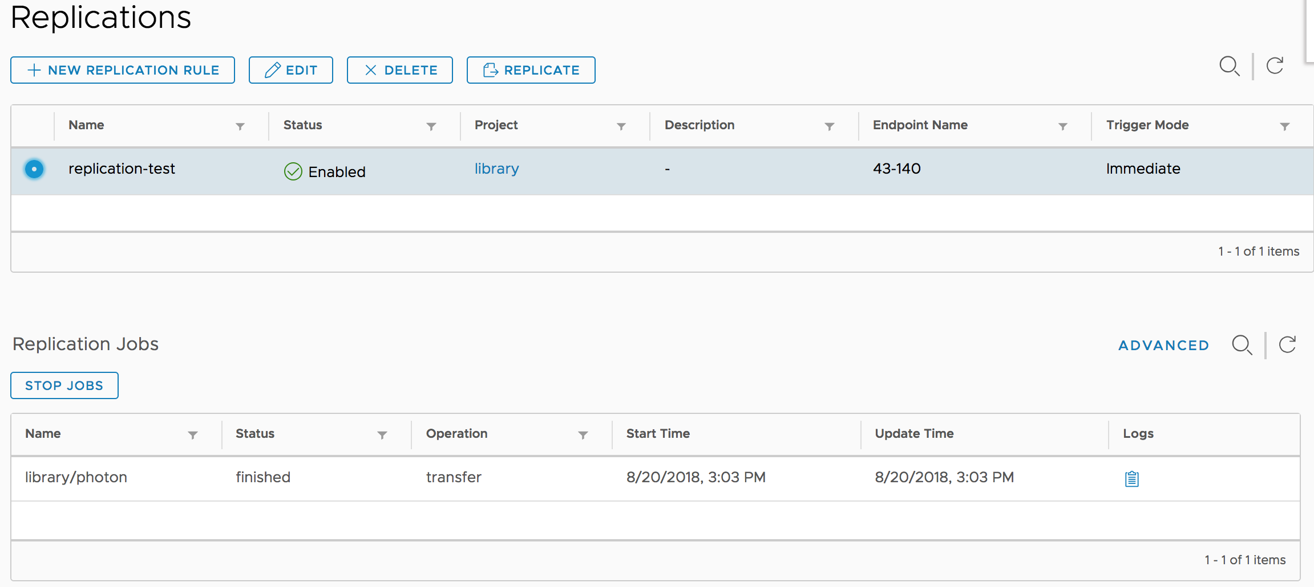
Replication – Sync content
Image Replication
Policy based
Project oriented
Incremental replication
Filters supported
Multi trigger modes
Filters

Slide 11
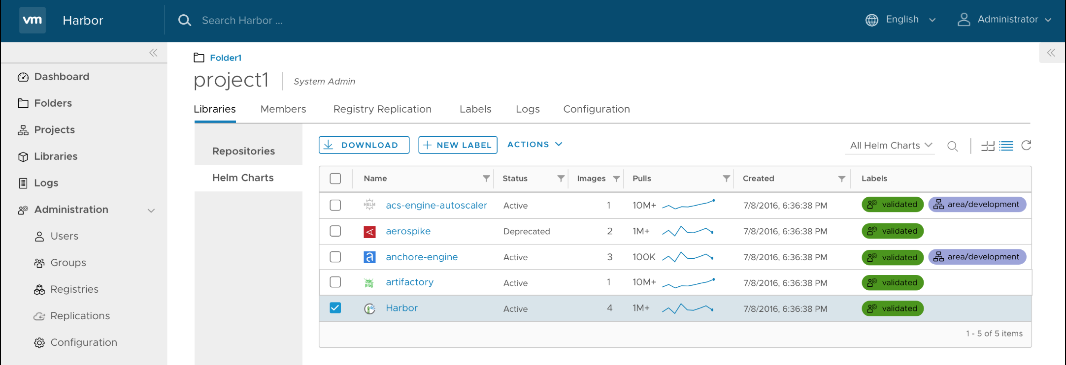
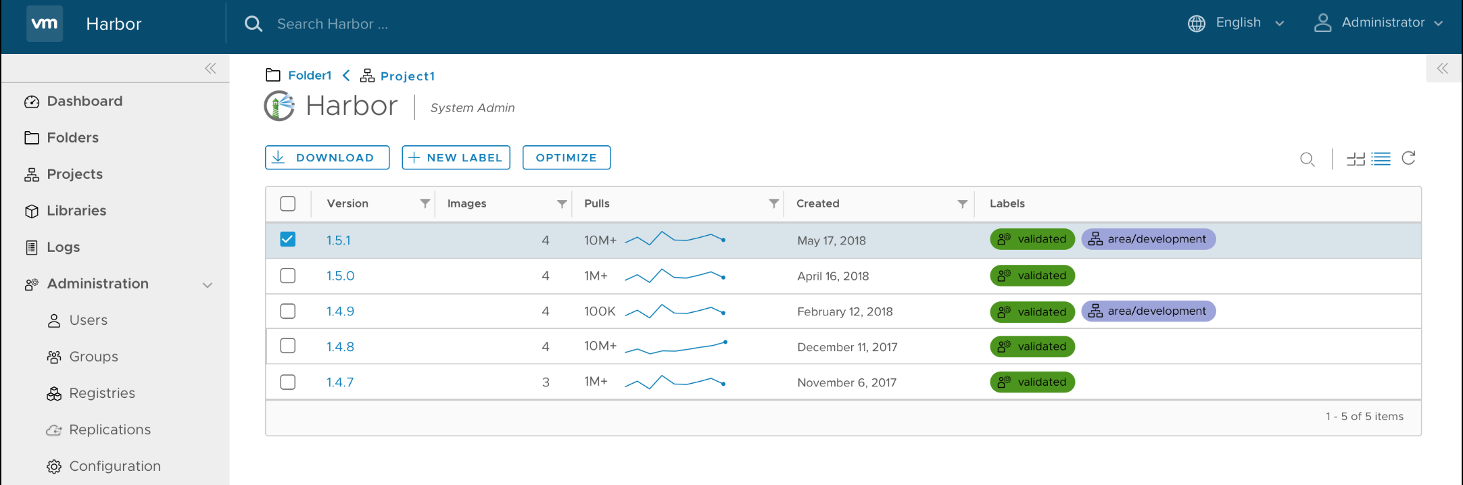
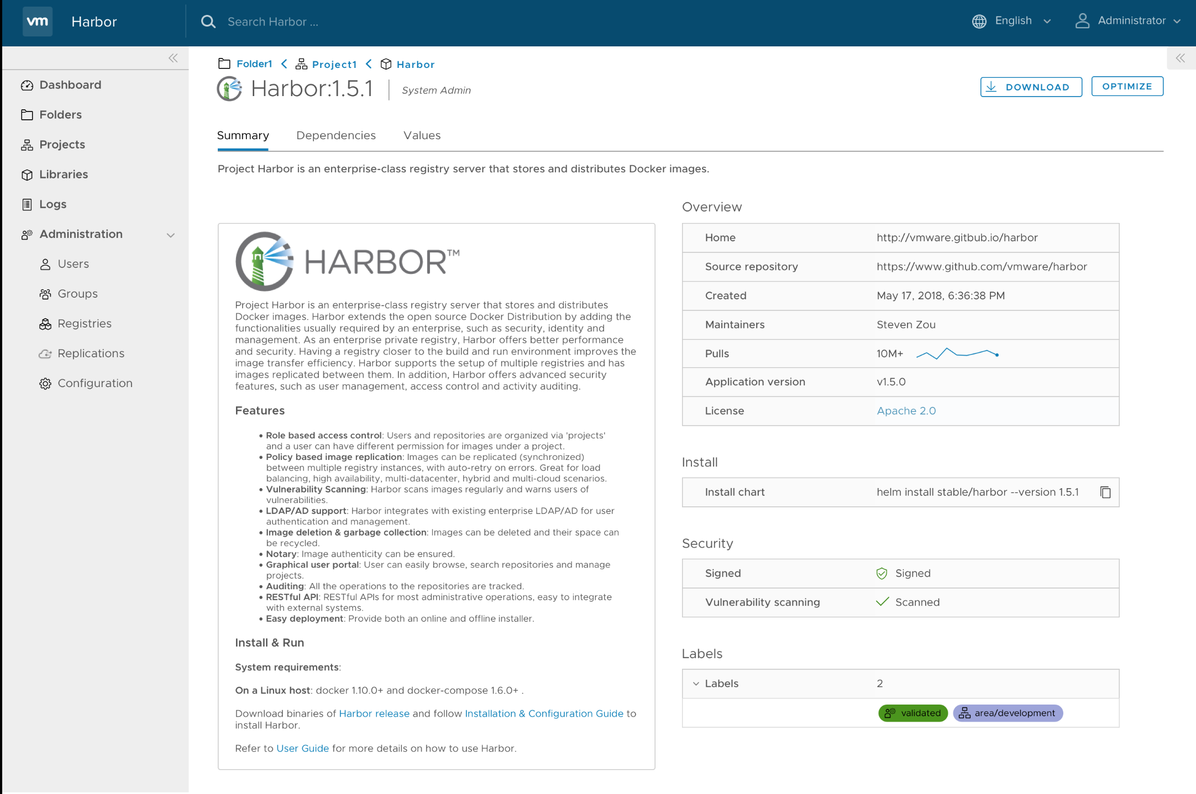
Helm Chart Repository – Serve K8s
Chart List
Supported
Versions
MANAGE
DOWNLOAD
UPLOAD
DELETE
Details
To be support
TRUST
VERIFY&SCAN
REPLICATE
EXPORT/IMPORT
11

Slide 12
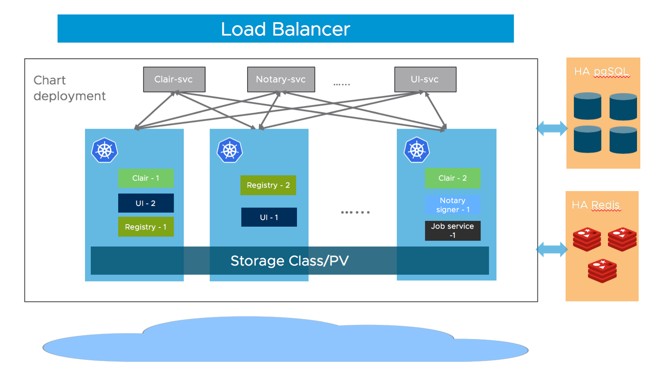
High Availability
High Availability
Available via helm chart deployment
HA Relation DB and Redis are not contained in Harbor chart distribution

Slide 13





More Features
Web Portal
Restful API
Internationalization
Based on open source Clarity
Image operation full capabilities
Batch operations
Complete API for integration
Swagger API doc
English
中文
Español
Français
Português do Brasil
Audit Log
Label
Multi Deployments
Operations recorded for audit
Label in project and system scopes
Mark labels to image and chart
Docker Compose
BOSH/Pivotal Tile
Helm Chart

Slide 14


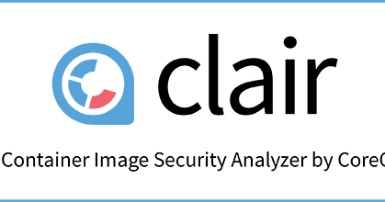



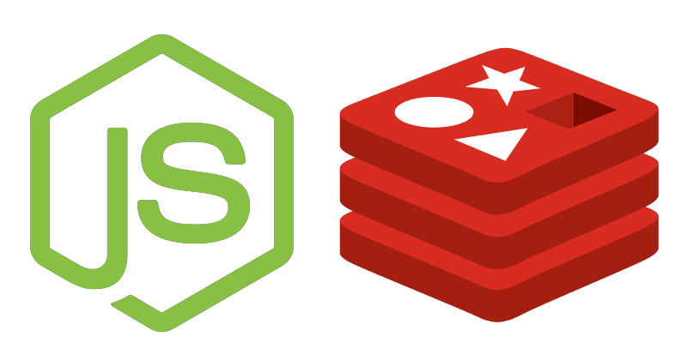

Harbor Architecture
Consumers
Users (GUI/API)
Container Schedulers/Runtimes
3rd party components
Harbor components
Persistence components
Supporting services
API Routing
LDAP/AD
Core Service
(API/Auth/GUI/Chart)
Trusted Content
Docker
Harbor Packaging
Kubernetes
Image Registry
Chart Museum
Job Service
Admin Service
Vulnerability Scanning
Cloud Foundry
Key/Value Storage
SQL Database
Local or Remote Storage (block, file, object)

Slide 15
Open Source P2P Based Image Distribution System

Slide 16
Introduction
An Open Source P2P Based Image Distribution System
https://github.com/dragonflyoss/Dragonfly

Slide 17
Features
Distribution Efficiency
P2P based image distribution
Passive CDN to avoid repetitive downloads
Distribution Flow Control
Task level and Host level net speed limit
Disk protection and high efficient IO
Distribution Security
Image distribution security via encrypting the image transmission
Simple and Easy to Use
Non-invasive support all kinds of container technologies
Pull container image as usual

Slide 18

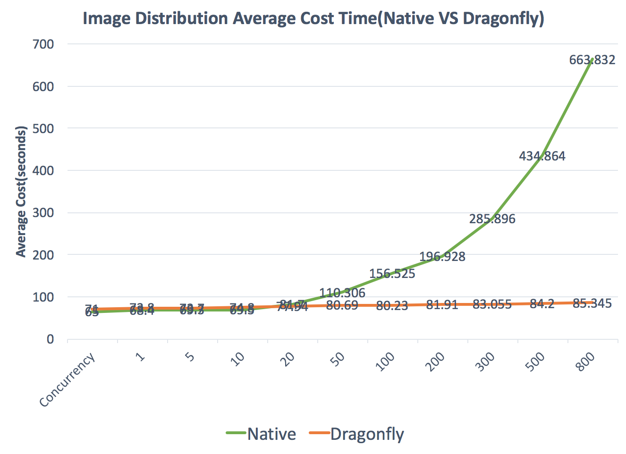
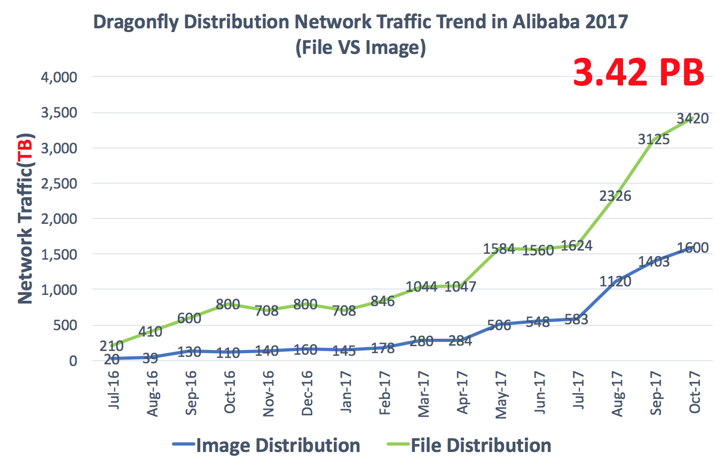
Dragonfly In Production
Distribution Efficiency
Distribution Statistics

Slide 19
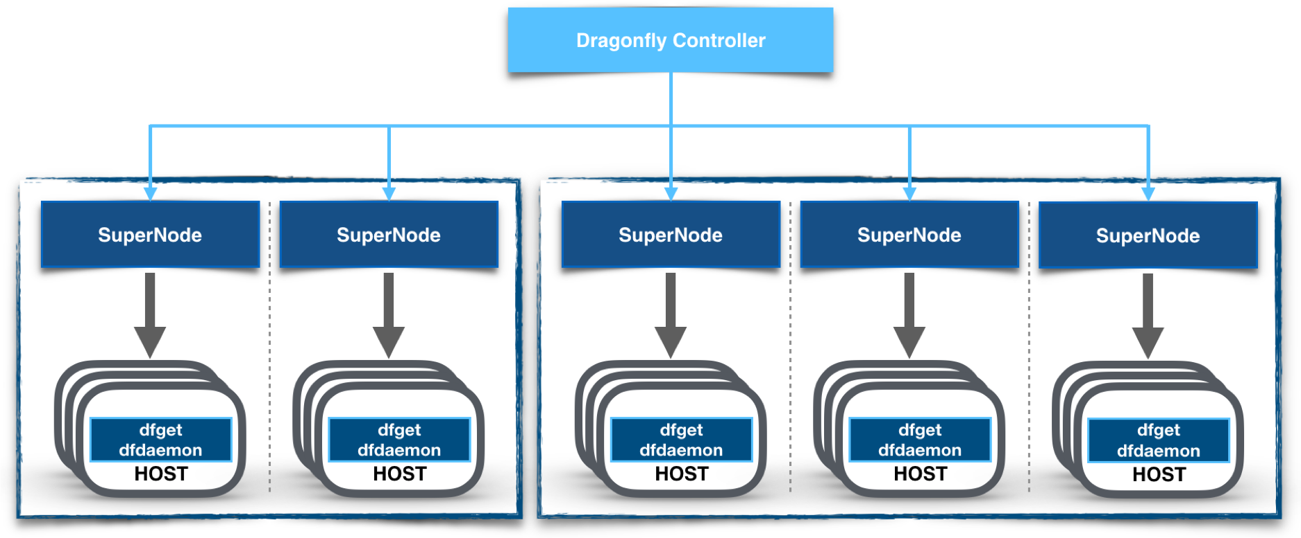
Architecture-Overview
Supernode： contains P2P scheduler and CDN manager
dfget: a tool to download files and plays a role of peer to distribute data
dfdaemon: a proxy for container engine to pull images

Slide 20
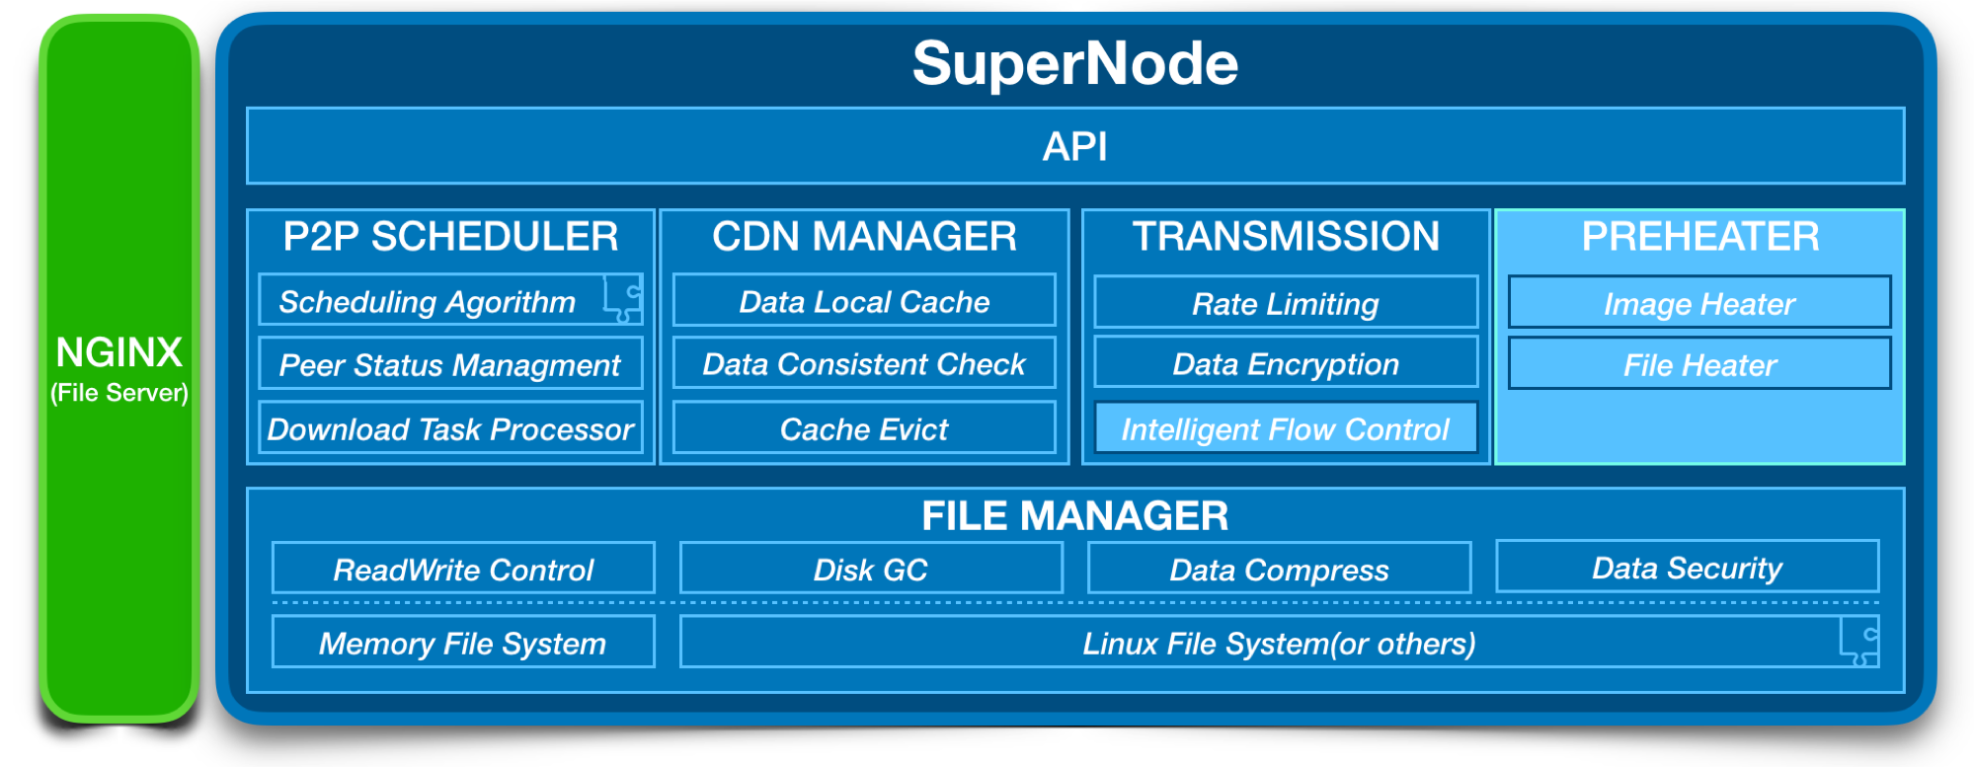
Architecture-Supernode

Slide 21
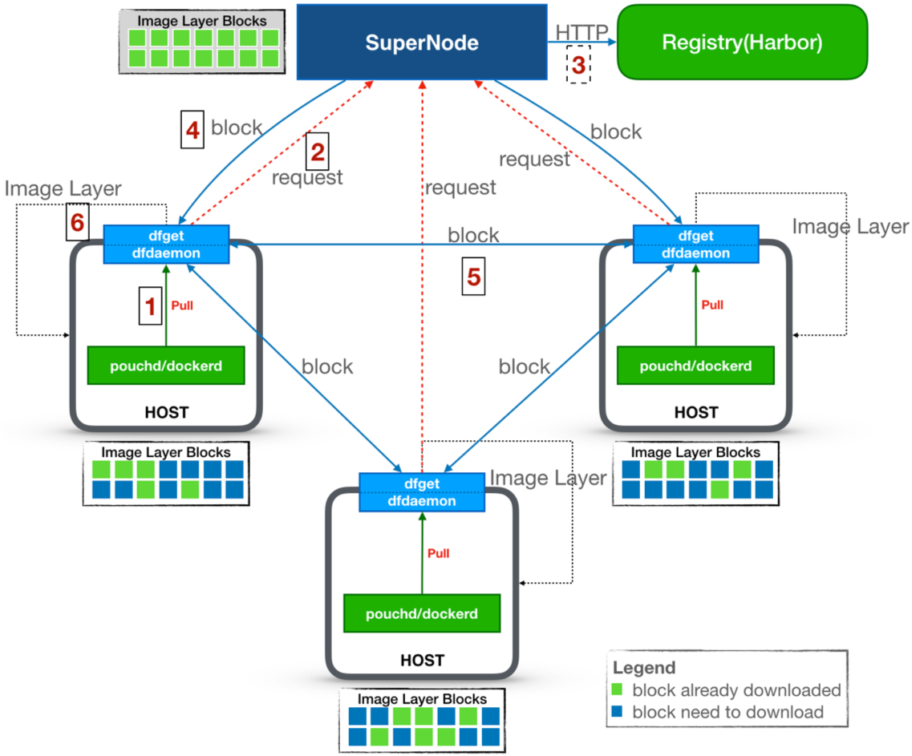
Workflow
Pull image from node proxy
Send pulling requests to SuperNode
Cache image from Registry if non-exist
Reply to node peers which have blocks
Transport blocks among all peers
Finish whole pulling when all blocks downloaded

Slide 22
Dragonfly in Ecosystem
Storage
(OSS)
ImageRegistry
(distribution/harbor)
SuperNode - Helm
dfGet - DaemonSet
SuperNode
Kubernetes
dfGet
kubelet
dfGet
kubelet
dfGet
kubelet
pouchd
pouchd
pouchd
container
container
container
container
container
container

Slide 23
Integration

Slide 24



Main Idea
Full Stack Image Management
Image Management
Image Distribution
Identify
Harbor
Dragonfly
Service Endpoint
Content Cache
Images
Preheat
P2P
Distribute (pull)
Runtime
Runtime
Runtime

Slide 25
Integration Architecture
Supported
Harbor：
Cover image management
Dragonfly：
Cover image distribution
Cooperation：
One click preheating in Harbor console
Supernode management via Harbor
Future
Policy based trigger

Slide 26
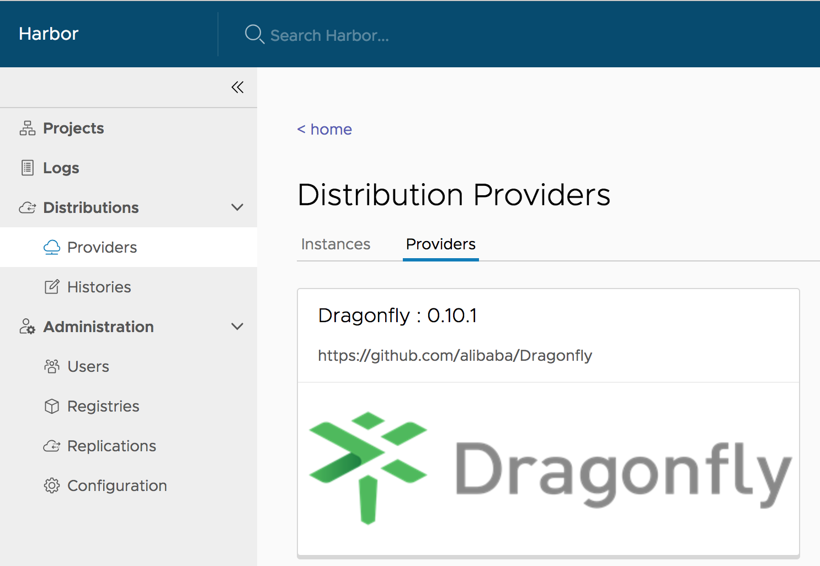
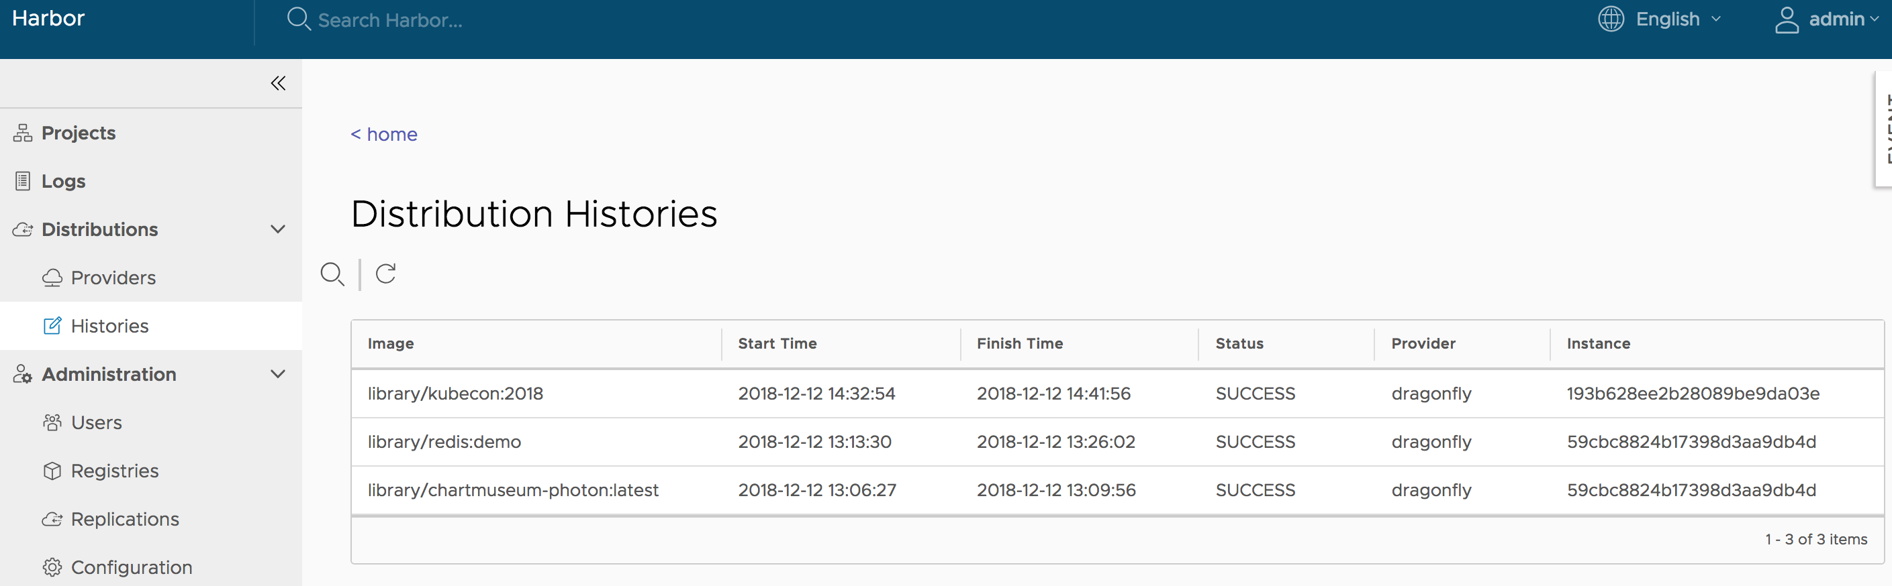
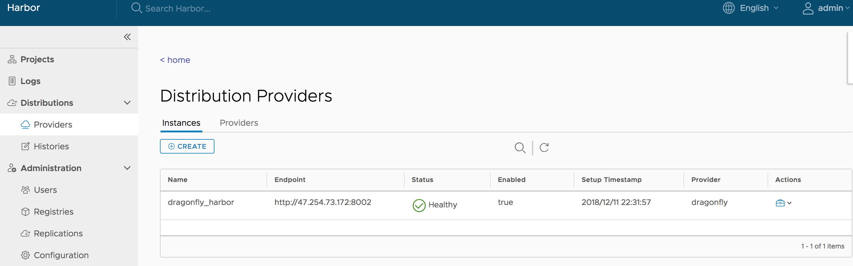
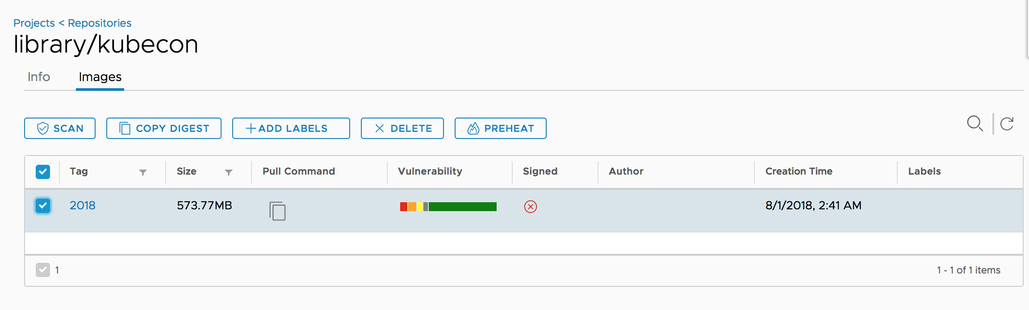
Management Console

Slide 27

Demo Time (5 mins)

Slide 28

Thank you!

